Slide 1
MOBILE AND WIRELESS NETWORKS-ATTACKS
29 SEPTEMBER 2026

Slide 2
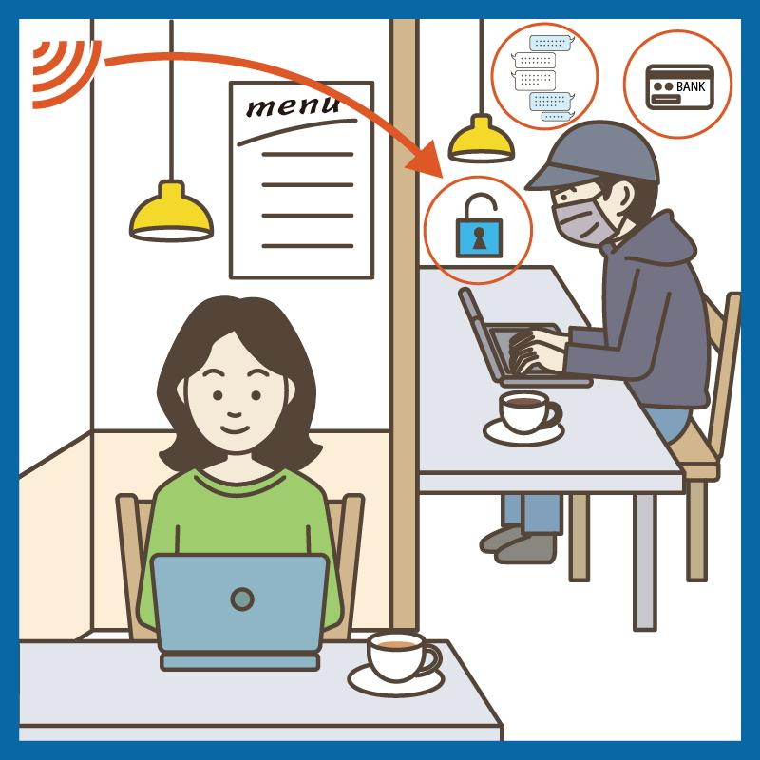
Man-in-the-middle attack
An attack in which an attacker secretly positions themselves between the victim and the intended destination.
Communication may pass through the attacker
Allowing information to be observed or altered.
Notes:
Use https encryptions
Avoid unsecured public wifi
U create a hotspot for your friends then you can monitor their traffic

Slide 3
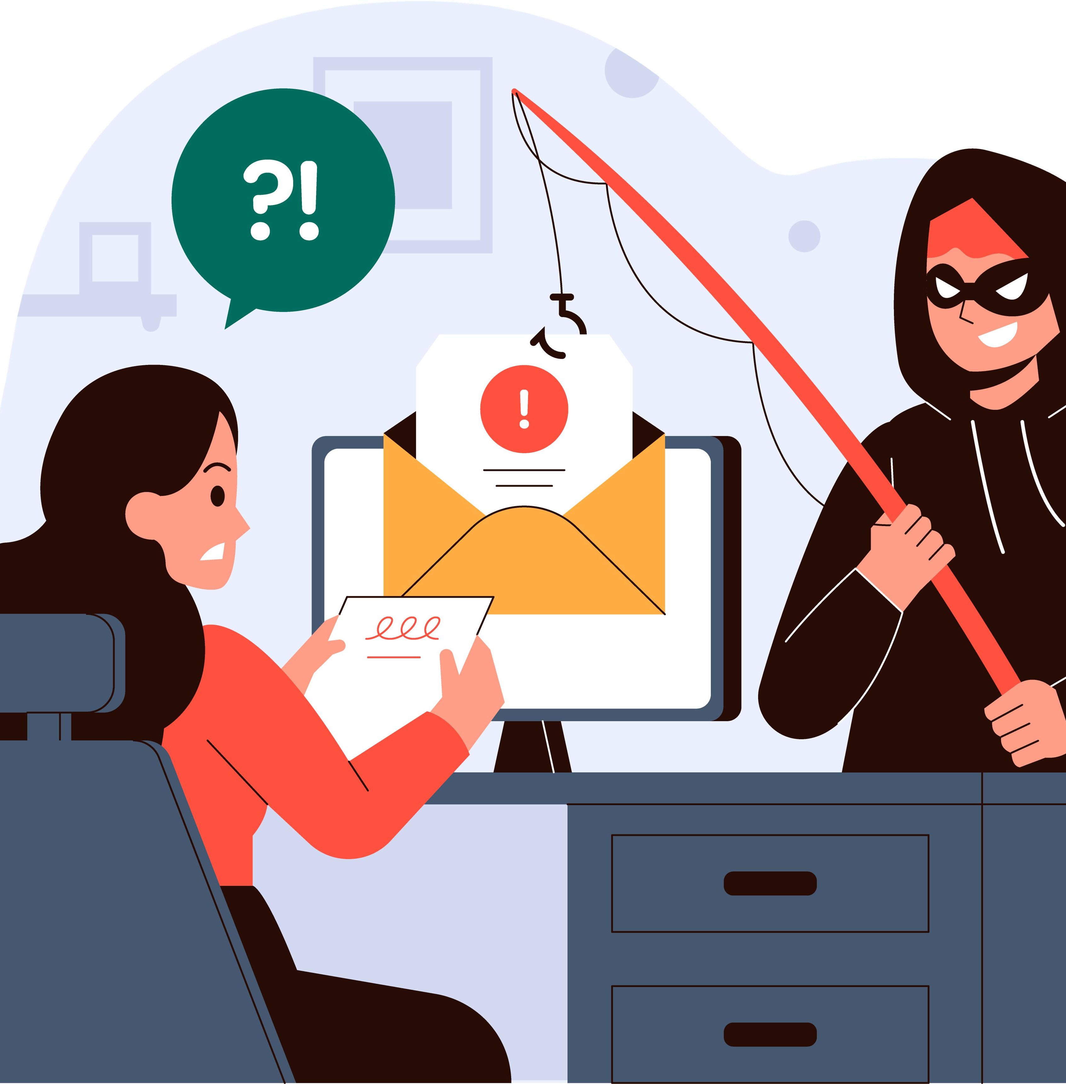
Phishing attack
Social-engineering attack where the attacker impersonates a trusted person or organization to trick a victim into revealing sensitive information,
Usernames, passwords, or banking details.
Attacker creates a convincing fraudulent email, SMS, or message that appears to come from a legitimate organization.
Message may contain a malicious link leading to a fake login page
When victim enters their credentials, the information is captured by the attacker.

Slide 4
How to protect yourself?
Verify the sender before responding or clicking links
Do not open suspicious links or attachments
Check website addresses before entering credentials
Use spam and email security filters

Slide 5
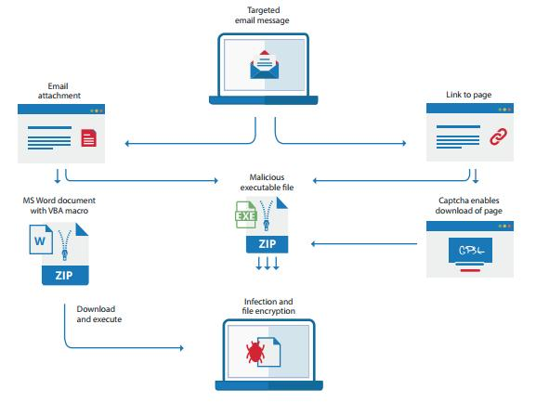
Malware attack
Malware involves malicious software designed to gain unauthorized access, steal information, disrupt operations, spy on users, or damage computer systems. Examples include viruses, worms, Trojans, spyware, and ransomware.
An attacker may disguise malware as a legitimate file, application, email attachment, or download. Once the victim opens or installs the malicious content, the malware executes on the device and performs its intended malicious activities.
Install and regularly update anti-malware/antivirus software.
Keep OS and applications patched and updated.
Do not download software or attachments from untrusted sources.

Slide 6
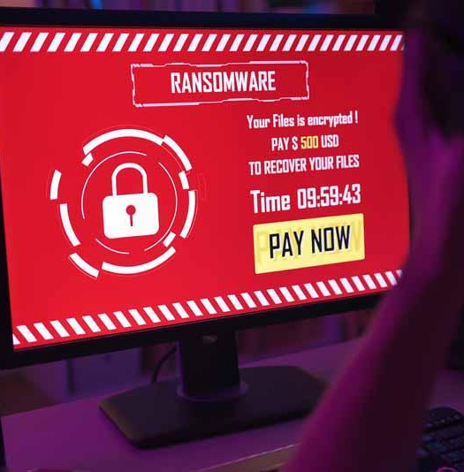
Ransomware attack
An attacker encrypts or blocks access to a victim’s files or systems and demands payment, usually in exchange for restoring access.
through phishing emails, malicious attachments, compromised websites, vulnerable software, or stolen credentials.
Once executed, it can encrypt files and may spread to other accessible systems.
The victim is then presented with a ransom demand.
Notes:
Maintain regular offline or isolated backups
Keep OS & applications patched

Slide 7
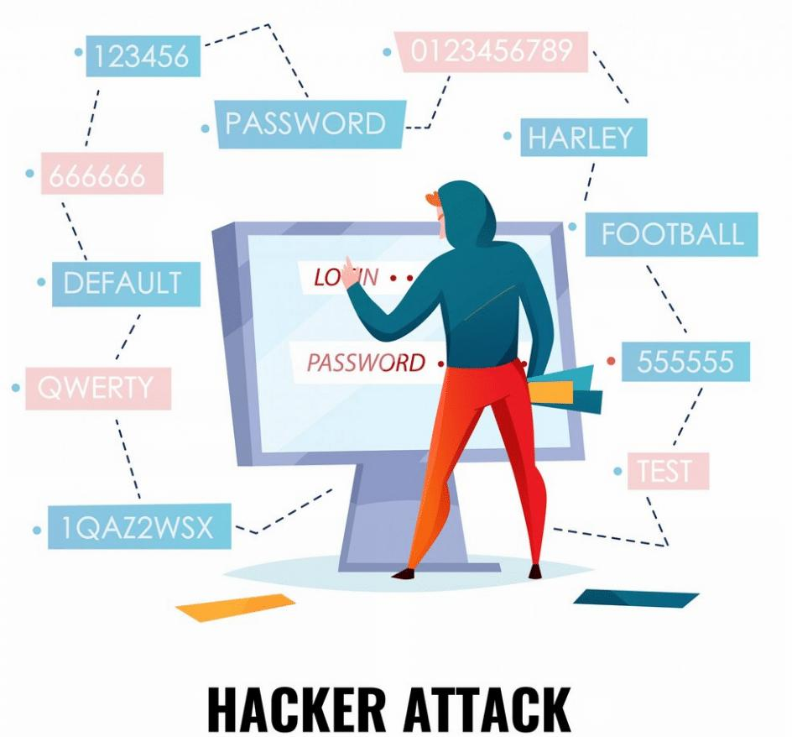
Brute force attack
A brute-force attack is an attempt to gain unauthorised access to an account or system by systematically trying many possible passwords or credentials until the correct one is found.
The attacker uses automated software to make repeated login attempts using different password combinations. Weak, short, common, or reused passwords are particularly vulnerable. Some variations use lists of previously leaked usernames and passwords.
Use long, unique passwords or passphrases.
Implement account lockout or login throttling after repeated failures.
Use rate limiting on authentication systems.
Monitor and alert on repeated failed login attempts.

Slide 8
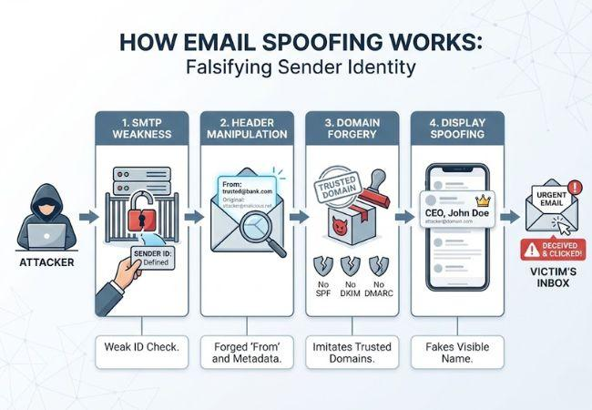
Spoofing attack
Occurs when an attacker pretends to be a trusted user, device, system, or communication source by falsifying identity information. Common examples include IP spoofing, email spoofing, ARP spoofing, and DNS spoofing.
The attacker falsifies identifying information so that malicious communication appears to originate from a legitimate source. For example, an attacker may forge an email sender address to make a message appear to come from a trusted organization, or manipulate network information to impersonate another device.
Use strong authentication and MFA.
Verify suspicious emails and requests before responding.
Notes:
Receive an email that appears to come from their university IT department saying
“ your university account will be disabled today. Click here to verify your account”

Slide 9
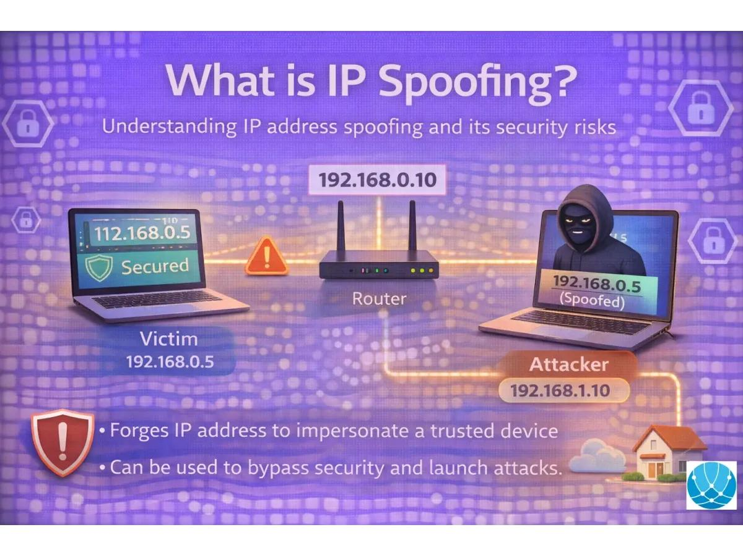
Eavesdropping (sniffing)
An eavesdropping attack, also called packet sniffing, occurs when an attacker secretly captures and monitors network communications to obtain information being transmitted between devices.
If the traffic is not properly encrypted, sensitive information such as usernames, passwords, messages, and other confidential data may be exposed.
The attacker gains a position where network traffic can be observed, such as an insecure or compromised network. Packet-capturing software may then be used to inspect traffic traveling across that network. Unencrypted communications are particularly vulnerable because their contents may be readable.
Use encrypted communication protocols, such as HTTPS/TLS.
Secure wireless networks using WPA2 or WPA3.
Avoid transmitting sensitive information over unsecured public Wi-Fi.

Slide 10
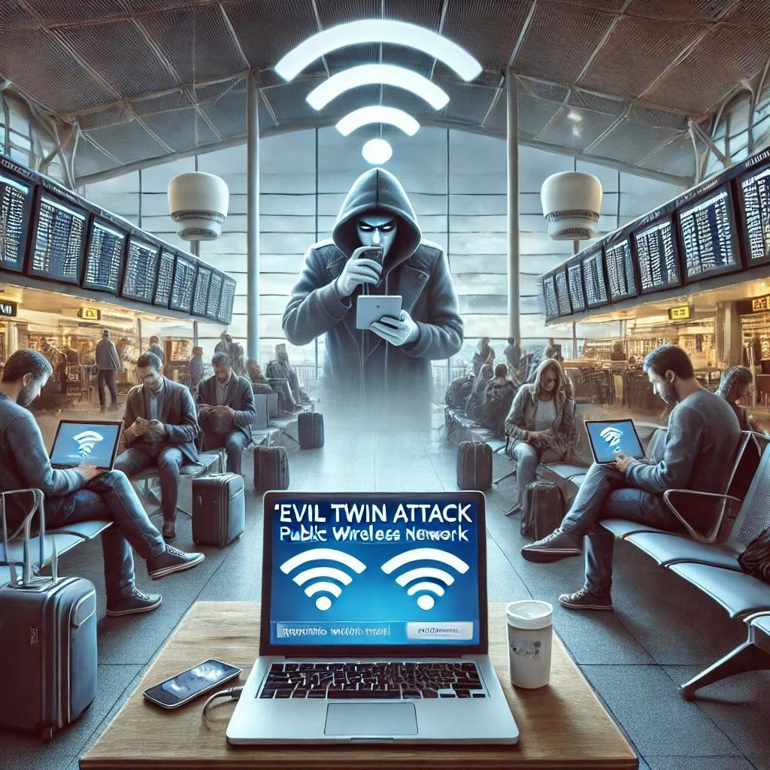
Evil twin attack
An Evil Twin attack is a wireless attack in which an attacker creates a fake Wi-Fi access point that imitates a legitimate network. The aim is to trick users into connecting to the attacker-controlled network.
The attacker sets up a rogue wireless access point using a network name (SSID) that matches or closely resembles a trusted Wi-Fi network. A victim may unknowingly connect to the fake access point, allowing the attacker to observe or manipulate traffic passing through it.
Verify the Wi-Fi network name before connecting.
Disable automatic connection to unknown or previously used public networks.
Avoid accessing sensitive accounts through untrusted public Wi-Fi.
Use HTTPS/TLS and a trusted VPN where appropriate.

Slide 11
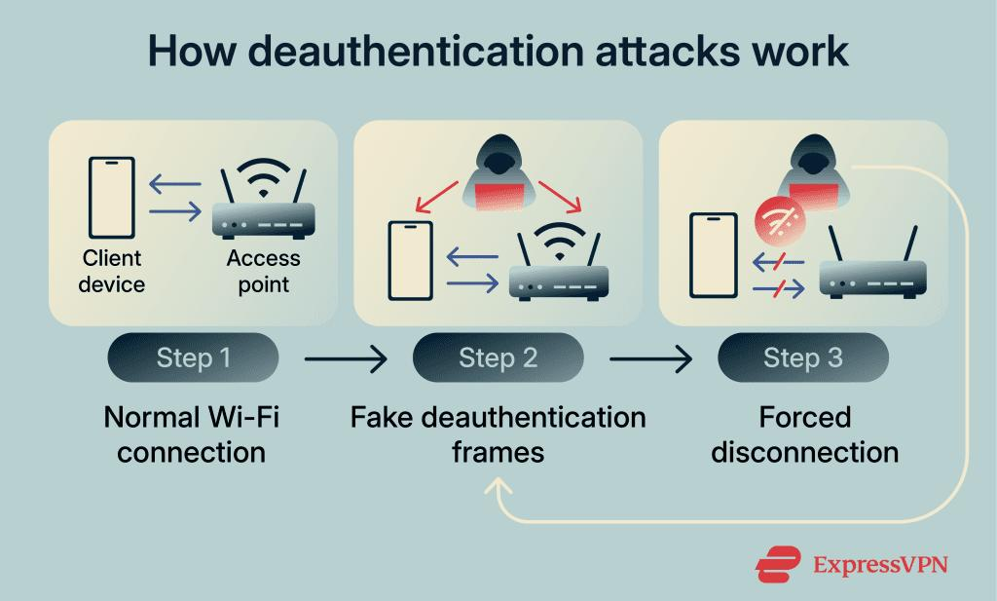
Deauthentication attack
wireless network attack in which an attacker causes connected devices to disconnect from a Wi-Fi access point by abusing Wi-Fi management frames.
It primarily targets the availability of wireless communication.
The attacker sends forged deauthentication frames that appear to originate from a legitimate access point or client.
Devices receiving these frames may disconnect from the Wi-Fi network and attempt to reconnect. Repeated forged frames can cause continuing wireless disruption.

Slide 12
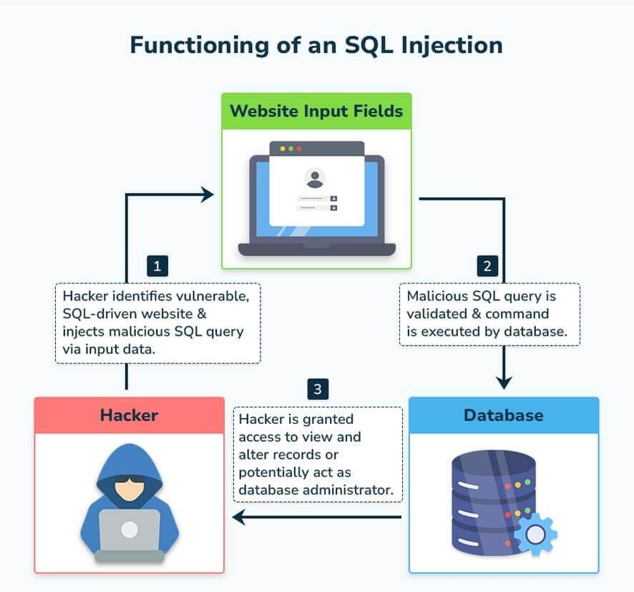
Sql injection
An SQL Injection (SQLi) attack targets applications that interact with databases. It occurs when an application improperly handles user input, allowing malicious input to alter database queries.
A successful attack may expose, modify, or delete sensitive database information
The attacker identifies an application input, such as a login form, search field, or URL parameter, that is not securely handled. Specially crafted input can then change the intended database query, potentially causing the application to perform unauthorised database operations.
Use parameterised queries/prepared statements.Validate and appropriately handle user input.

Slide 13
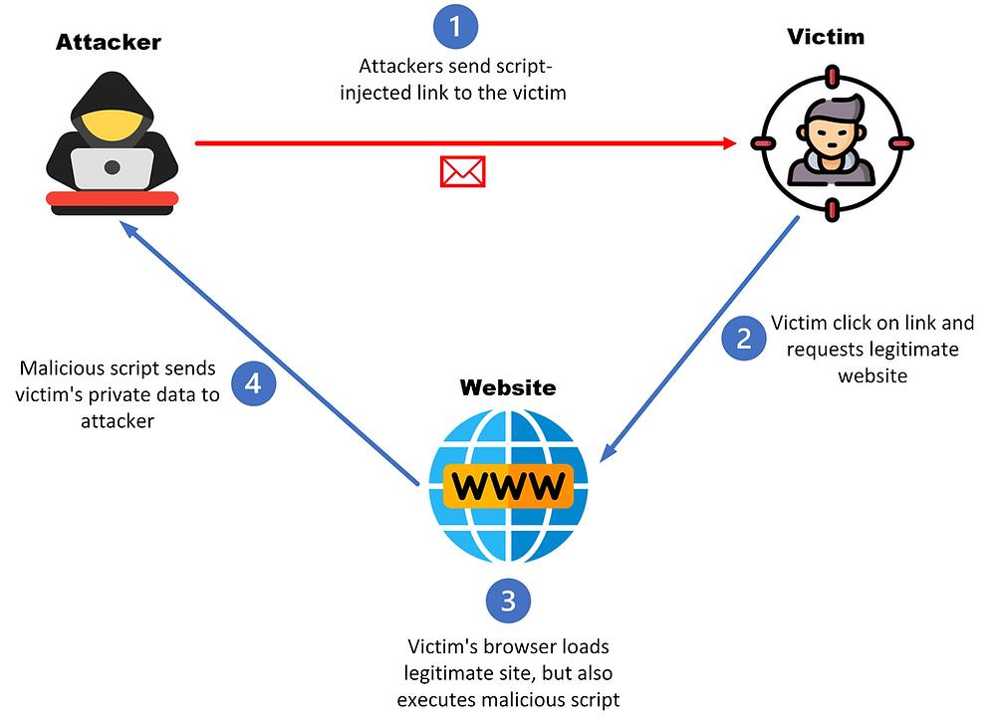
Cross-site scripting
A Cross-Site Scripting (XSS) attack is a web application attack in which malicious script content is introduced into a trusted website and then executed in another user's browser.
Attackers can use it to steal session information, manipulate webpage content, redirect users, or perform actions using the victim's session.
The attacker finds a web application that does not properly handle user-controlled content. Malicious script content is submitted through areas such as comment fields, search boxes, forms, or URL parameters. When another user's browser processes the affected page, the malicious script may execute.
Notes:
Apply proper output encoding/escaping.Validate and sanitise user-controlled input where appropriate.
Implement a strong Content Security Policy (CSP).

Slide 14
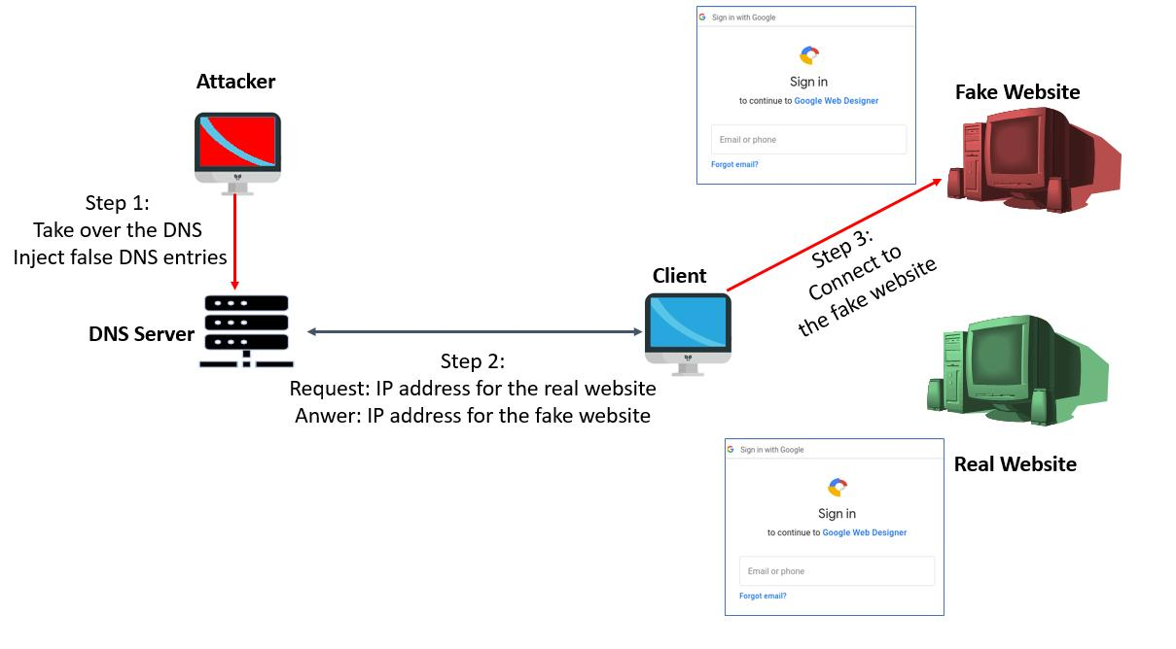
Dns spoofing
A DNS spoofing attack occurs when false DNS information causes a user to be redirected to the wrong IP address, potentially sending them to a malicious website even though they entered the correct domain name.
The attacker introduces false DNS information into the name-resolution process. When the victim requests a legitimate website, the manipulated DNS response associates that domain with an attacker-controlled IP address. The victim may then be redirected to a convincing fake website where credentials or other sensitive information can be stolen.
Use DNSSEC where supported to authenticate DNS data.
Keep DNS servers and network infrastructure patched and updated.
Use trusted and securely configured DNS resolvers.

Slide 15
Scope for quiz same as for test 2

